Slide 1
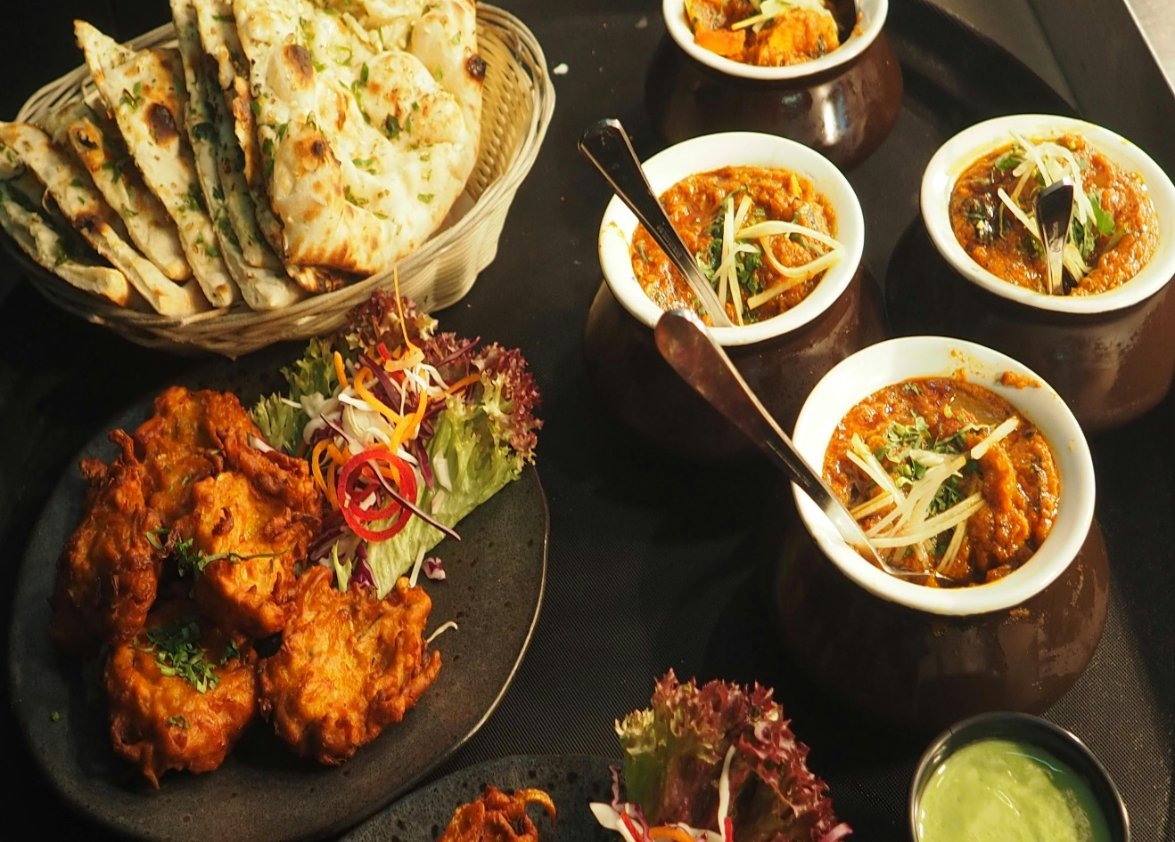
SQL Case Study - Foodie-Fi
Analyzing Data for Food Fi Company Using SQL
By Abdullah Zunorain
5 April 2024

Slide 2
Introduction to Food-Fi company
Brief Overview of Foodie-Fi:
Foodie-Fi: A subscription-based streaming service launched in 2020.
Industry: Positioned within the streaming media sector, specializing in culinary content.
Unique Selling Point: Offers exclusive access to a diverse range of cooking shows and food-related content.
Target Audience: Caters to people who love food and cooking and want specialized shows.
Competition: Operates in a market dominated by general entertainment streaming platforms like Netflix, Hulu, and Amazon Prime.
Market Differentiation: Stands out by focusing solely on culinary content, providing subscribers with unlimited on-demand access to food-related videos from around the world.
Business Model: Generates revenue through monthly and annual subscription plans, offering subscribers unrestricted access to premium culinary content.

Slide 3
Introduction to the Case Study and its Objectives
Background: Food Fi is a subscription-based streaming service launched in 2020, specializing in food-related content.
Objective: The case study aims to showcase how Food Fi utilizes data analysis using SQL to make informed business decisions.
Data-Driven Approach: Food Fi operates with a data-driven mindset, ensuring that all decisions, including investment choices and feature development, are based on data insights.
Purpose: Through this case study, we aim to demonstrate how SQL queries are used to analyze Food Fi's subscription data and derive valuable insights for business growth and decision-making.
Key Goals: The primary objectives include understanding customer preferences, optimizing pricing strategies, analyzing cohort behavior, optimizing customer acquisition, and reducing churn through data-driven strategies.
Value Proposition: By harnessing SQL for data analysis, Food Fi can gain actionable insights to enhance customer satisfaction, improve retention, and drive business success in the competitive streaming media industry.

Slide 4
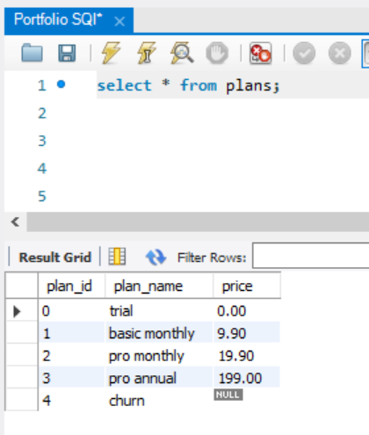
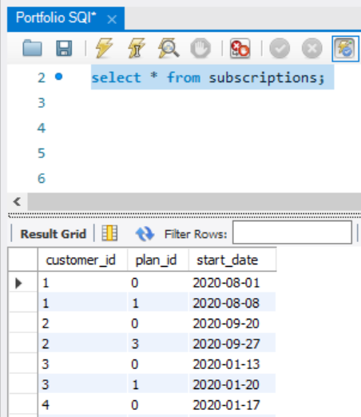
Data Description
The dataset used in the case study consists of two main tables within the Food Fi database schema. Below are the details of each table along with their columns and meanings:
Table 1: plans
plan_id: Unique identifier for each subscription plan.
plan_name: Name of the subscription plan (e.g., trial, basic monthly, pro monthly, pro annual, churn).
price: Price associated with each subscription plan. For some plans like the trial and churn, the price may be null.
Table 2: subscriptions
customer_id: Unique identifier for each customer.
plan_id: Identifier referencing the subscription plan chosen by the customer.
start_date: Date when the subscription plan started for the customer.
These tables provide essential data for analyzing customer subscription patterns, understanding plan preferences, and tracking customer engagement over time. The plan_id column serves as a foreign key linking the subscriptions table with the plans table, allowing for comprehensive analysis of subscription data.
Plans table-1
Subscriptions table-2
The dataset is available at the following link: https://tinyurl.com/food-fi

Slide 5
Business Problems and Objectives
Business Problems:
Subscription Retention: Food Fi faces challenges in retaining subscribers and reducing churn rates.
Understanding Customer Preferences: Lack of insights into customer preferences regarding subscription plans and content preferences.
Optimizing Pricing Strategy: Need to determine the most effective pricing strategy to attract and retain customers while maximizing revenue.
Objectives of Using SQL for Data Analysis:
Identifying Patterns: Utilize SQL to analyze subscription data and identify patterns in customer behavior, such as subscription trends and viewing habits.
Optimizing Plans: Use SQL to analyze subscription data and tailor subscription plans to match customer preferences, thereby improving retention rates.
Price Optimization: Employ SQL to analyze pricing data and determine optimal price points for subscription plans, balancing revenue generation with customer satisfaction and retention.

Slide 6
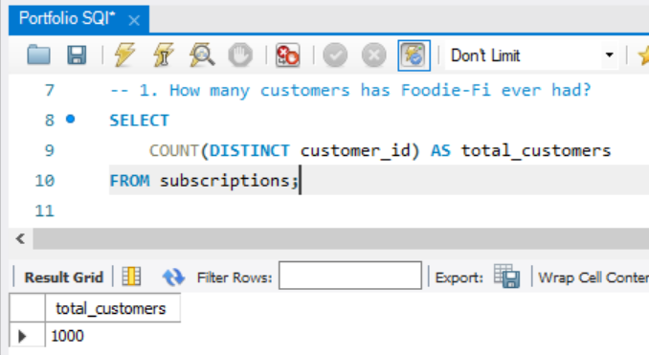
SQL Queries and Analysis
1. How many customers has Foodie-Fi ever had?
SQL CODE:
SELECT COUNT(DISTINCT customer_id) AS total_customers
FROM subscriptions;
Explanation:
The first query calculates the total number of unique customers that Foodie-Fi has ever had by counting the distinct customer IDs from the subscriptions table. In this case, the result is 1000, indicating that Foodie-Fi has had 1000 unique customers over the specified time period.

Slide 7
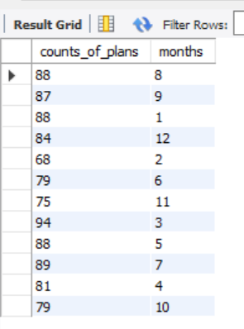
Continue...
2. What is the monthly distribution of trial plan start_date values for our dataset use the start of the month as the group by value?
SQL CODE:
select
count(plan_id) as counts_of_plans,
month(start_date) as months
from subscriptions
group by months, plan_id
having plan_id=0;
Explanation:
The above query calculates the monthly distribution of trial plan start_date values for the dataset. It groups the data by the start month of each trial plan and counts the occurrences of trial plan start dates within each month. The `plan_id` column is filtered to only include trial plans (where `plan_id` equals 0). Finally, the results are displayed with the count of trial plans and the corresponding month of their start_date values.

Slide 8
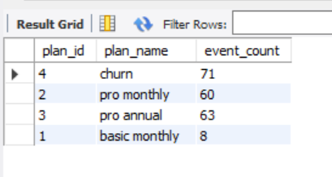
Continue...
3. What plan start_date values occur after the year 2020 for our dataset? Show the breakdown by count of events for each plan_name?
SQL CODE:
select
s.plan_id,
p.plan_name,
count(p.plan_name) as event_count
from subscriptions s inner join plans p
ON s.plan_id = p.plan_id
where year(s.start_date) > 2020
group by s.plan_id, p.plan_name;
Explanation:
The above query groups the data by plan_id and plan_name, counting the occurrences of each plan_name. Finally, it presents the breakdown of events by plan_name along with the corresponding event_count.

Slide 9
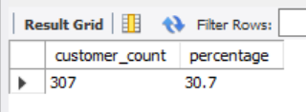
Continue...
4. What is the customer count and percentage of customers who have churned rounded to 1 decimal place?
SQL CODE:
select
count(distinct customer_id) as customer_count,
round((count(distinct customer_id)/(SELECT COUNT(DISTINCT customer_id) FROM subscriptions)) * 100, 1) as percentage
from subscriptions
where plan_id=4;
Explanation:
This query calculates the customer count and percentage of customers who have churned, rounded to 1 decimal place. It first counts the number of distinct customer IDs where the plan_id is equal to 4 (indicating churn). Then, it divides this count by the total count of distinct customer IDs in the subscriptions table, multiplying by 100 to get the percentage. The result shows that 307 customers have churned, which is approximately 30.7% of the total customer base.

Slide 10
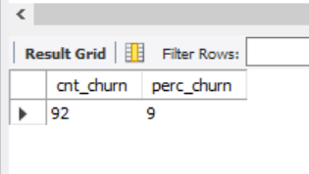
Continue...
5. How many customers have churned straight after their initial free trial - what percentage is this rounded to the nearest whole number?
SQL CODE:
WITH cte_churn AS (
SELECT *, LAG(plan_id, 1) OVER(PARTITION BY customer_id) AS prev_plan
FROM subscriptions )
SELECT COUNT(prev_plan) AS cnt_churn,
ROUND(COUNT(*) * 100/(SELECT COUNT(DISTINCT customer_id) FROM subscriptions),0) AS perc_churn
FROM cte_churn
WHERE plan_id = 4 and prev_plan = 0;
Explanation:
The SQL code identifies customers who churned immediately after their initial free trial. It calculates the count and percentage of such customers, which are 92 and approximately 9%, respectively.

Slide 11
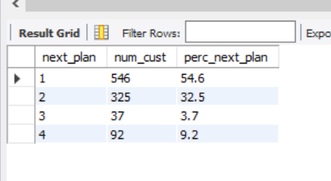
Continue...
6. What is the number and percentage of customer plans after their initial free trial?
SQL CODE:
WITH cte_next_plan AS (
SELECT *,
LEAD(plan_id, 1) OVER(PARTITION BY customer_id ORDER BY plan_id) AS next_plan
FROM subscriptions )
SELECT next_plan,
COUNT(*) AS num_cust,
ROUND(COUNT(*) * 100/(SELECT COUNT(DISTINCT customer_id) FROM subscriptions),1) AS perc_next_plan
FROM cte_next_plan
WHERE next_plan is not null and plan_id = 0
GROUP BY next_plan
ORDER BY next_plan;

Slide 12
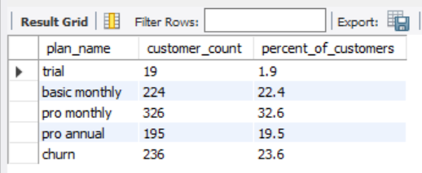
Continue...
7. What is the customer count and percentage breakdown of all 5 plan_name values at 2020 12-31?
SQL CODE:
WITH My_CTE AS (
SELECT *, ROW_NUMBER() OVER(PARTITION BY customer_id ORDER BY start_date DESC) as rwnmbr
FROM subscriptions
WHERE start_date <= '2020-12-31')
SELECT
plan_name,
COUNT(customer_id) as customer_count,
ROUND((COUNT(customer_id)/(SELECT COUNT(DISTINCT customer_id) FROM My_CTE))*100,1) as percent_of_customers
FROM My_CTE mc INNER JOIN plans as P
ON mc.plan_id = P.plan_id
WHERE rwnmbr = 1
GROUP BY plan_name;

Slide 13
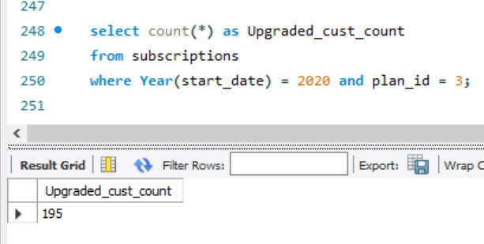
Continue...
8. How many customers have upgraded to an annual plan in 2020?
SQL CODE:
select count(*)
from subscriptions
where Year(start_date) = 2020 and plan_id = 3;
Explanation:
The above SQL code counts the number of customers who upgraded to an annual plan in the year 2020. It filters the subscriptions table to include only records where the start_date occurred in 2020 (`Year(start_date) = 2020`) and the plan_id matches the identifier for the annual plan (`plan_id = 3`). The result indicates that 195 customers upgraded to an annual plan in 2020.

Slide 14
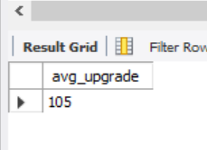
Continue...
9. How many days on average does it take for a customer to an annual plan from the day they join Foodie-Fi?
SQL CODE:
with
trail_plan AS (
select customer_id, start_date as trail_dates from subscriptions where plan_id=0 ),
annual_plan as (
select customer_id, start_date as annual_dates from subscriptions where plan_id=3 )
select ROUND(AVG(DATEDIFF(annual_dates, trail_dates)),0) AS avg_upgrade
from annual_plan ap join trail_plan tp
ON ap.customer_id = tp.customer_id;

Slide 15
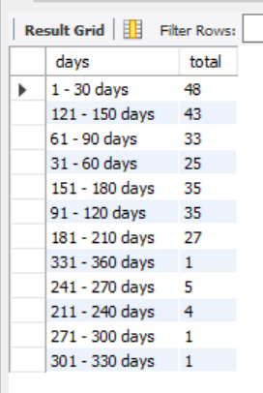
Continue...
10. Can you further breakdown this average value into 30 day periods (i.e. 0-30 days, 31-60 days etc)
SQL CODE:
WITH annual_plan AS (
SELECT customer_id,
start_date AS annual_date
FROM subscriptions WHERE plan_id = 3 ),
trial_plan AS (
SELECT customer_id,
start_date AS trial_date
FROM subscriptions
WHERE plan_id = 0 ),
day_period AS (
SELECT DATEDIFF(annual_date, trial_date) AS diff
FROM trial_plan tp LEFT JOIN annual_plan ap
ON tp.customer_id = ap.customer_id
WHERE annual_date is not null),
bins AS (
SELECT *,
FLOOR(diff/30) AS binsFROM day_period)
SELECT CONCAT((bins * 30) + 1, ' - ', (bins + 1) * 30, ' days ') AS days,
COUNT(diff) AS total
FROM bins
GROUP BY bins;

Slide 16
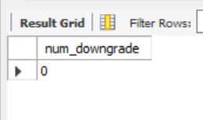
Continue...
11. How many customers downgraded from a pro monthly to a basic monthly plan in 2020?
SQL CODE:
WITH next_plan AS (
SELECT *,
LEAD(plan_id, 1) OVER(PARTITION BY customer_id ORDER BY start_date, plan_id) AS plan
FROM subscriptions)
SELECT COUNT(DISTINCT customer_id) AS num_downgrade
FROM next_plan np LEFT JOIN plans p
ON p.plan_id = np.plan_id
WHERE p.plan_name = 'pro monthly' AND np.plan = 1 AND start_date <= '2020-12-31';

